Slide 1
Web Server Load Balancing
Thomas Robertazzi,
Dept. of Electrical & Comp. Eng.
Stony Brook University

Slide 2
Tiers
High speed links from ISP to web site
Routers
Load Balancing Server
Server Farm (hundreds of PCs)

Slide 3
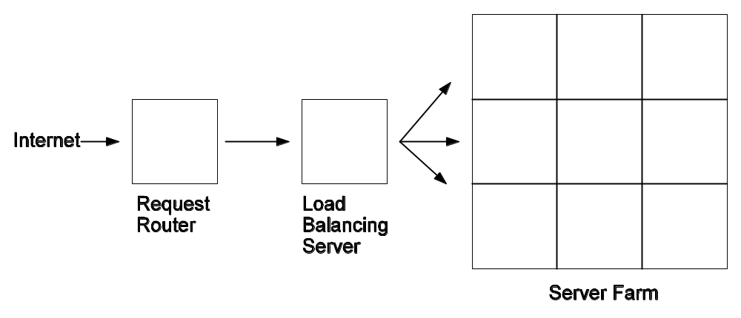
Typical Load Balancing System

Slide 4
Some Points
Mainframes were an old solution.
Use cluster of servers for scalability today.
Internal servers linked by high speed Ethernet versions (e.g. Fast Ethernet or Gigabit Ethernet).

Slide 5
More Points
To prevent single point of failure, use dual processors and dual disk drives.
Special software can direct same user to same server for same session.

Slide 6
Separate Servers
E-commerce websites often separate servers into groups. Each server optimized for its type of service:
(1) Catalog pages
(2) GIF files
(3) Text files
(4) Tech Support
(5) Secure credit card orders

Slide 7
Load Balancing Policies and Metrics
Load balancing policies include round robin, and rules involving:
(1) response time
(2) latency
(3) profitability of request

Slide 8
Web Site Effectiveness
A major web site must be able to handle thousands of clients, each establishing numerous sessions.
The site must look like a single entity despite its internal architecture.

Slide 9
More on Effectiveness
Effectiveness depends on:
Number of client sessions supported.
Volume of traffic steered to various servers.
Type of detectable server faults.
Security of connections.

Slide 10
Security Measures
Degrade responses to multiple SYN packets from same client address (SYN attack).
Degrade connections asking for same web page in rapid succession.
Refusing connections to/from suspicious addresses.

Slide 11
Capacity Expansion
Rule of thumb is to maintain 100% excess capacity.
To expand capacity may:
(1) Increase server speed.
(2) Add more servers to farm.
(3) Add new geographic data centers.
(4) Increase internal network speed.

Slide 12
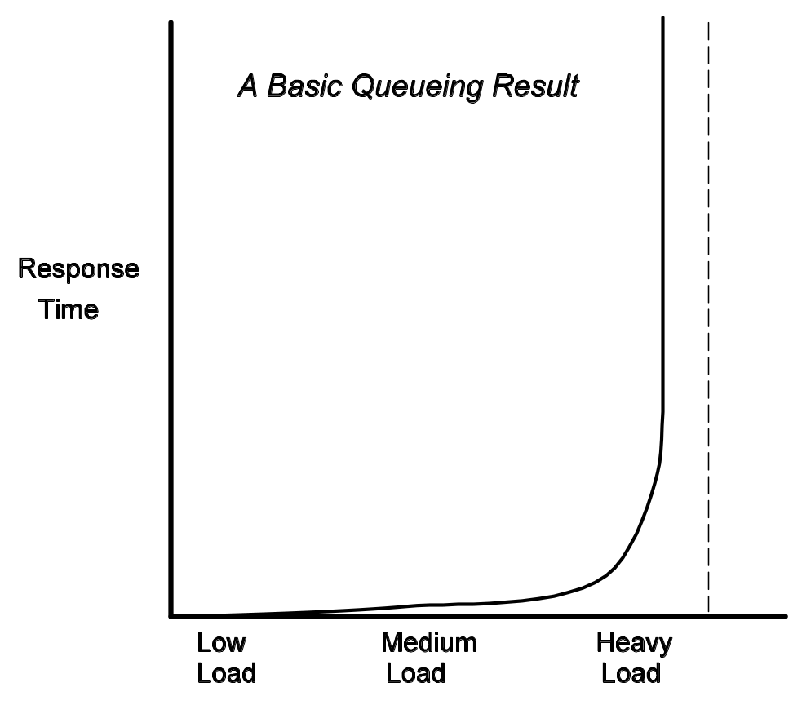
Typical Response Time versus Load Performance Curve

Slide 13
Response Time Growth
A basic relevant queueing model result is that as load increases, response time increases slowly, then at a certain point as load approaches capacity, almost exponentially.
Response Time is Ts/(1-U) where Ts is response time for very low load and U is utilization.

Slide 14
Response Time Growth Misconceptions
Web servers have no capacity limit, all jobs eventually completed though slowly.
Response time grows linearly as offered load increases.

Slide 15
But Actually!
Say avg. response time at 50%, increasing 2% a week.
Would think naively one has 6 months before capacity is reached.
But because of nonlinear shape of response time versus load curve, response time can go from good to terrible in a day or week.

Slide 16
Response Time
Depends on:
Network arrival rate
Avg. file size
Buffer size
Initialization time
Static and dynamic server times/rates
Server and client network data rate

Slide 17
Testing
Can generate synthetic test traffic though takes some effort and cost.
Test for:
(1) Capacity (max number of sessions).
(2) Rate (max rate at which sessions opened)
(3) Dynamic rate (rate at which small number of sessions open/close at max capacity).
Server hard failures.

Slide 18
One Final Note
The number of simultaneous open TCP connections is unlimited for most Windows NT and UNIX servers.
But there is an upper limit on such connections for Windows and Macintosh servers.

Slide 19
Let’s Surf the Web!!!

